Slide 1
Software Construction Laboratory CS35L – Lab 1
Course Webpage: https://web.cs.ucla.edu/classes/fall18/cs35L/index.html
TA: Zhiyi Zhang
Email: zhiyi@cs.ucla.edu
Webpage: https://zhiyi-zhang.com

Slide 2
Session 5-1
Hints for Assignment 4
Hints for Assignment 5

Slide 3
Hints for Assignment 4

Slide 4
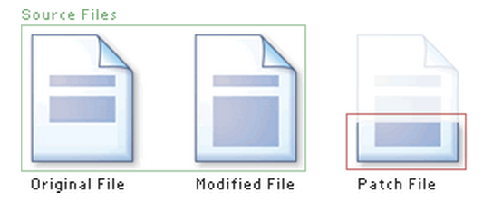
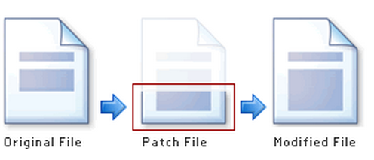
Recall: Applying the Patch to One File
Syntax: patch [original file] -i [patch file] -o [updated file]
patch command will apply the patch file to the original file and create an updated file

Slide 5
Applying the Patch to One Directory
Syntax: patch -p[num] < [patch file]
patch command will apply the patch file to the current directory
-p is used to strip the smallest prefix containing num leading slashes from each file name found in the patch file.
Example: in the patch: ---/usr/tmp/project/file1~ +++/usr/tmp/project/file1
When use -p3, the file path becomes file1 (use this when you call patch command in /usr/tmp/project directory)

Slide 6
Debugging the coreutil
One bug makes the compilation fail
Fix the bug by patching the patch
One bug makes the output in incorrect order
Fix the bug by debugger (GDB)
Pay attention to functions that is used for comparison (comparison functions decide the order)

Slide 7
qsort
qsort function
void qsort(void *ptr, // the pointer to the array to sort
size_t count, // the number of element in the array
size_t size, // size of each element in the array in bytes
int (*comp)(const void *, const void *) ); // comparison function
Use the function name (actually a pointer) as the parameter
The function must be in the format of:
int function_name(const void* arg1, const void* arg2)
Return negative/positive number if arg1 is smaller/larger than arg2. Return zero if they are the same

Slide 8
An Example of qsort Function
int
main(void) {
int ints[] = { -2, 99, 0, -743, 2, 100, 4 };
int size = sizeof ints / sizeof *ints;
qsort(ints, size, sizeof(int), compare_ints);
for (int i = 0; i < size; i++) {
printf("%d ", ints[i]);
}
printf("\n");
}
#include <stdio.h>
#include <stdlib.h>
int
compare_ints(const void* a, const void* b) {
int arg1 = *(const int*)a;
int arg2 = *(const int*)b;
if (arg1 < arg2) return -1;
if (arg1 > arg2) return 1;
return 0;
}

Slide 9
Use stdio.h for I/O
You can use int getchar() to read next char from stdin
You can use int putchar(int char) to write a char to the current position in stdout

Slide 10
Hints for Assignment 5

Slide 11
strace command
strace It allows one to quickly find out how a program is interacting with the OS by monitoring system calls and signals.
-t option to print out the time
-tt option to print out the time in microseconds
-T option to show the time spent in system calls

